Slide 1
Customer Churn Analysis using SQL & Machine Learning
Title: Customer Churn Analysis using SQL & Machine Learning Name: Khandalkar Sanchit Sanjay Course: Computer Engineering Tools Used: Python, SQL, Jupyter Notebook

Slide 2
Problem Statement
Customer churn is a major problem in telecom industry.
Companies lose revenue when customers leave
Identifying churn early helps in retention
Goal: Predict which customers are likely to leave

Slide 3
Objectives
Analyze customer data using SQL
Identify patterns behind churn
Build a machine learning model to predict churn
Segment customers into groups
Provide business recommendations

Slide 4
Dataset Description
Dataset: Telco Customer Churn Dataset
Features:
Age
Gender
Tenure
MonthlyCharges
Contract
PaymentMethod
TotalCharges
Churn (Target Variable)

Slide 5
Tools & Technologies
Python (Pandas, NumPy)
Machine Learning (Scikit-learn)
SQL (MySQL / SQLite)
Jupyter Notebook
Data Visualization (Matplotlib, Seaborn)

Slide 6
Methodology (Flow)
Data Collection
Data Cleaning
SQL Analysis
Data Visualization
Model Building
Evaluation
Customer Segmentation

Slide 7
SQL Analysis
Performed queries to extract insights:
Total customers
Churn vs Non-Churn count
Average Monthly Charges
Tenure analysis
Payment method analysis
SQL helped in understanding data patterns.

Slide 8
Key SQL Queries
Example:
SELECT Churn, COUNT(*) FROM churn_data GROUP BY Churn;
SELECT AVG(MonthlyCharges) FROM churn_data;
SELECT Churn, AVG(Tenure) FROM churn_data GROUP BY Churn;

Slide 9
Data Preprocessing (Python)
Removed unnecessary columns (CustomerID)
Handled missing values
Converted categorical data into numeric
Prepared data for model training

Slide 10
Exploratory Data Analysis
Churn distribution graph
Correlation heatmap
Identified important features
Insights:
High charges → more churn
Low tenure → more churn

Slide 11
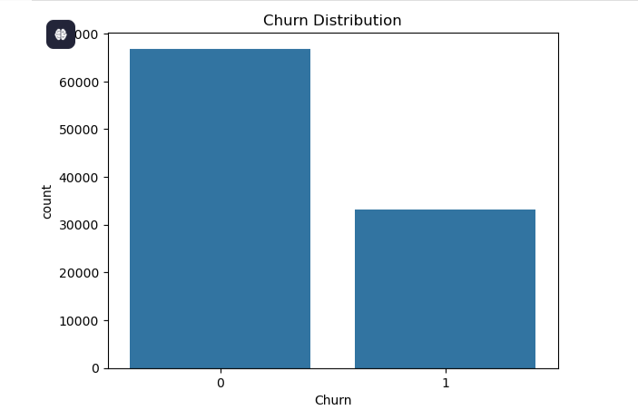

Slide 12
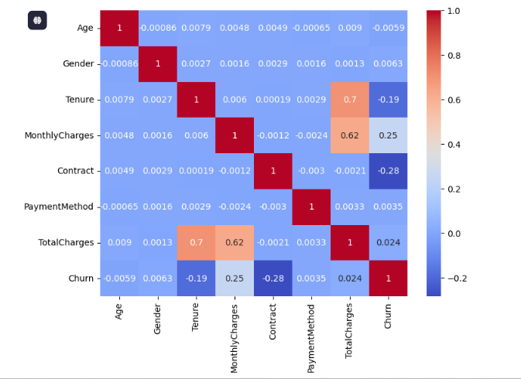

Slide 13
Model Building
Used Random Forest Classifier.
Why Random Forest?
High accuracy
Handles large data
Reduces overfitting

Slide 14
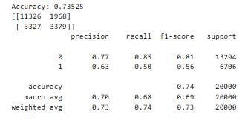
Model Evaluation
Accuracy Score
Confusion Matrix
Classification Report
Model predicts customer churn effectively.

Slide 15
Feature Importance
Important factors affecting churn:
MonthlyCharges
Tenure
Contract Type
These features influence customer decisions.

Slide 16
Customer Segmentation
Customers divided into:
At Risk → likely to churn
Loyal → long-term customers
Dormant → low activity
Helps in targeted marketing.

Slide 17
Business Insights
Customers with high monthly charges are more likely to churn
New customers churn more than old customers
Certain payment methods show higher churn

Slide 18
Recommendations
Offer discounts to high-risk customers
Promote long-term contracts
Improve service quality
Provide loyalty rewards

Slide 19
Conclusion
Successfully analyzed churn using SQL & Python
Built predictive model
Identified key factors affecting churn
Provided actionable insights

Slide 20
Future Scope
Use advanced models (XGBoost, Deep Learning)
Real-time churn prediction system
Dashboard integration (Power BI)

Slide 21
References
Kaggle Dataset
Python Documentation
Scikit-learn Documentation

Slide 22
Thank You..!!

